Slide 1
Проект по ООП-2 Производство на вина
Изготвили:
Александър Живков фак.№- 19621702
Владимир Андреев фак.№- 19621703

Slide 2
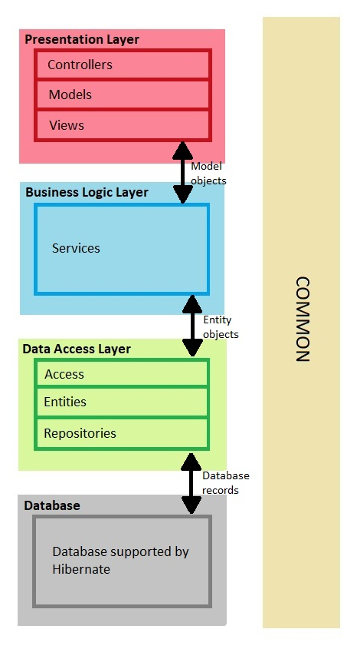
Структура и модули на проекта

Slide 3
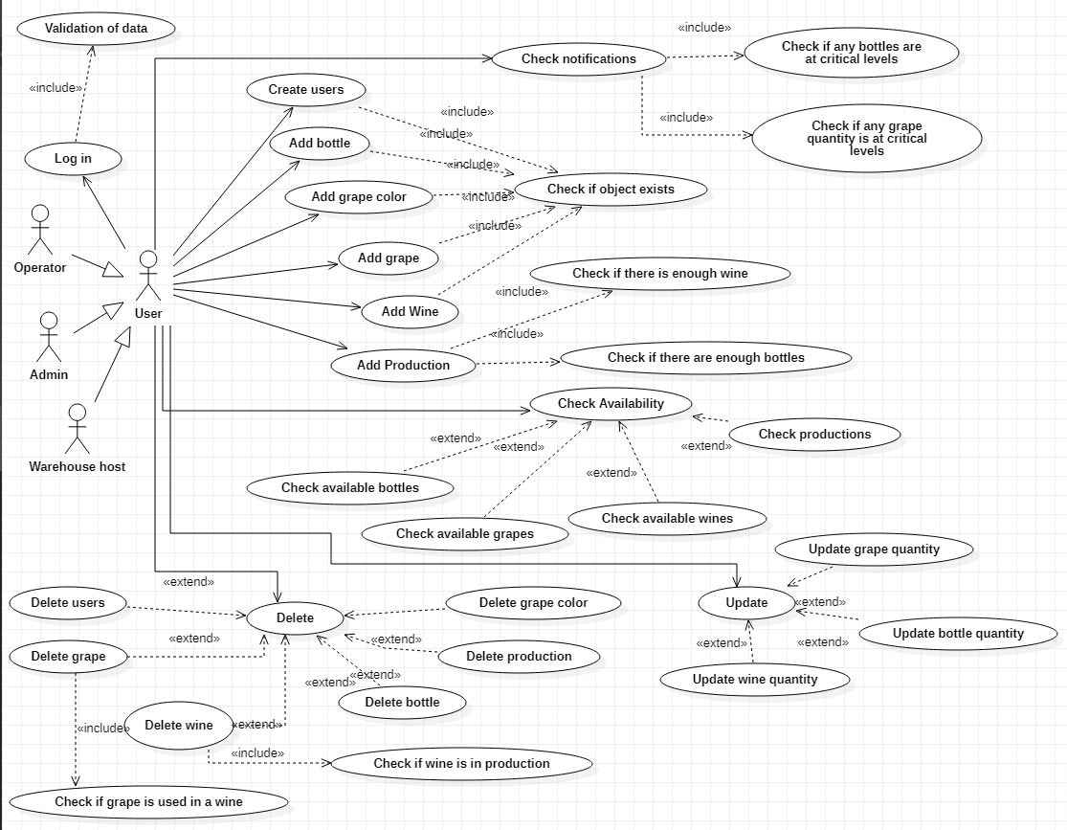
Use Case Diagram

Slide 4
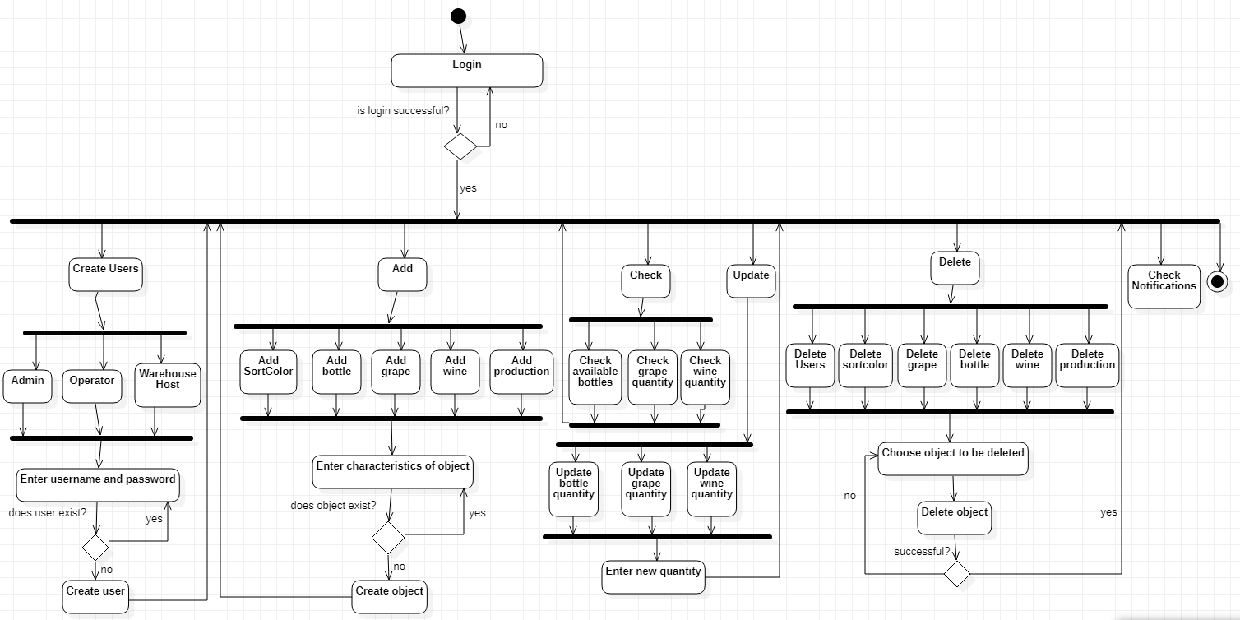
Activity Diagram

Slide 5
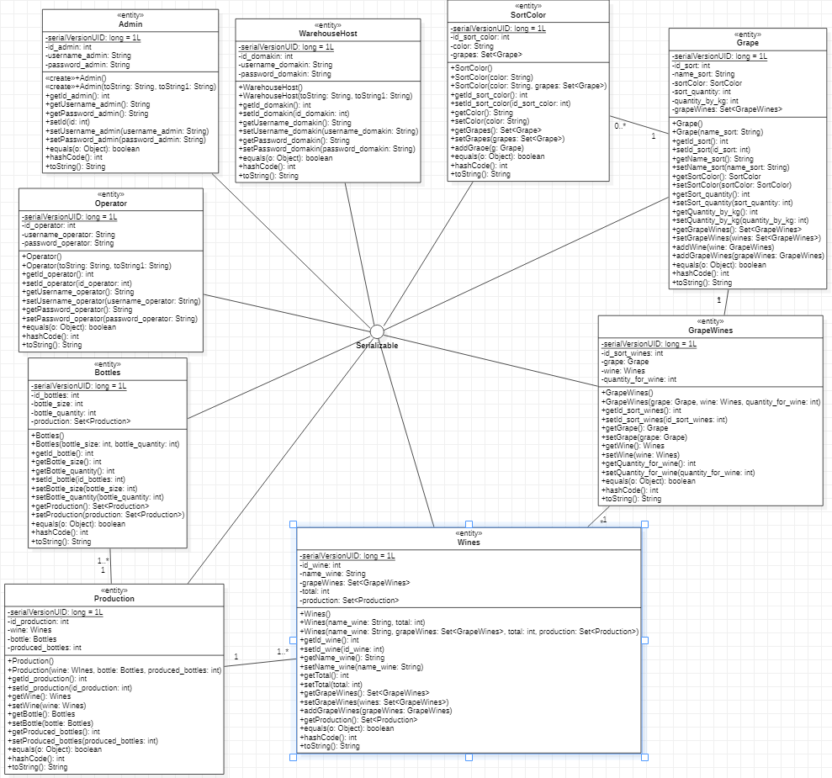
Entities – Class Diagram

Slide 6
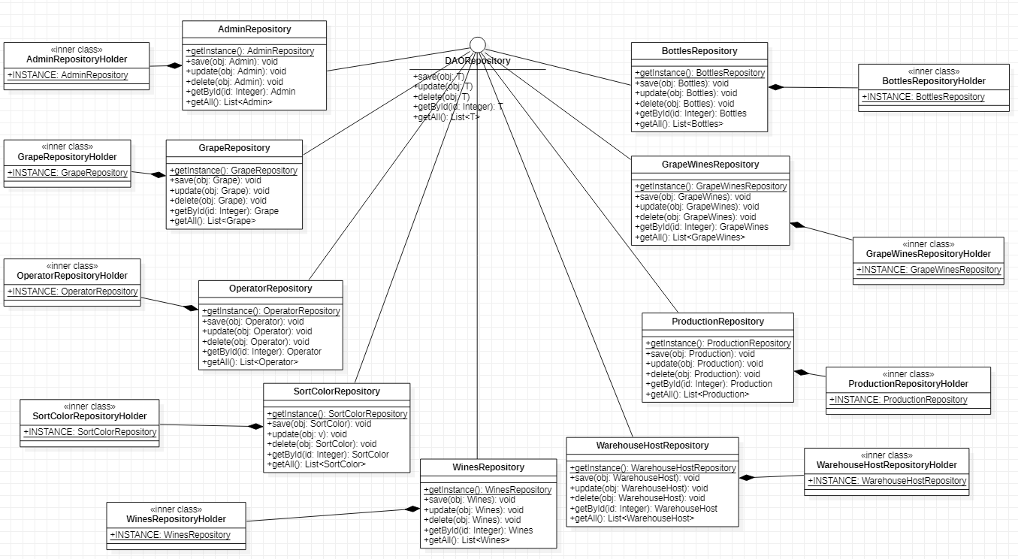
Repositories – Class Diagram

Slide 7
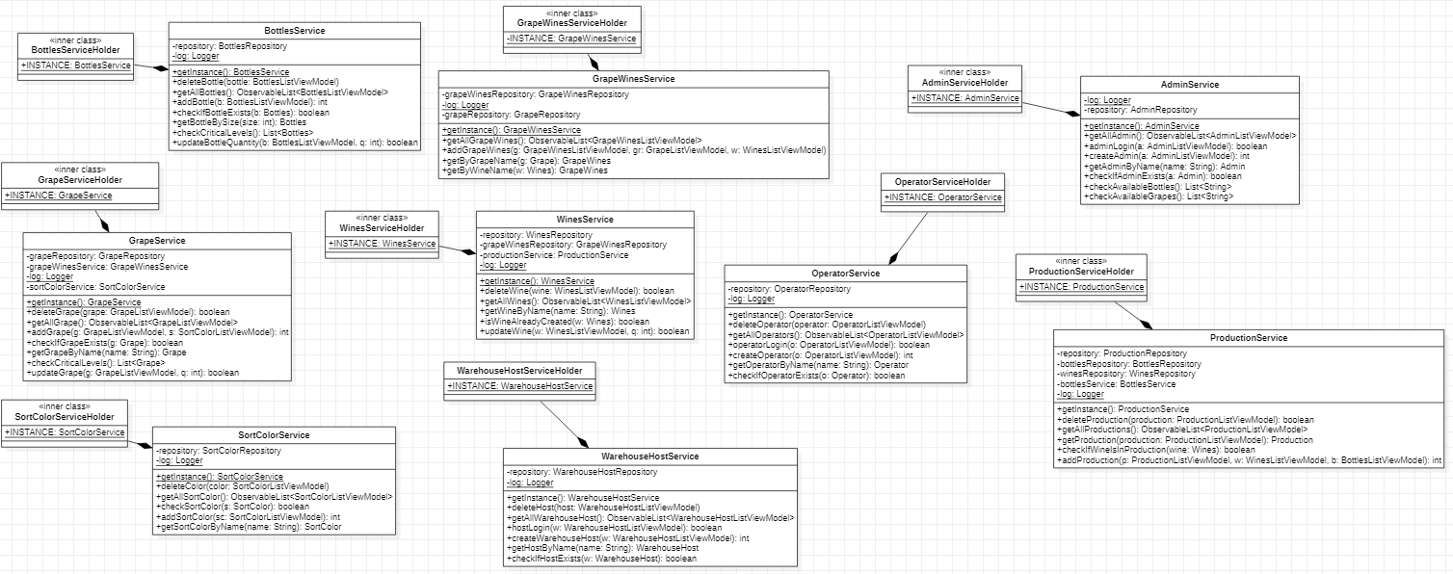
Business Services – Class Diagram

Slide 8
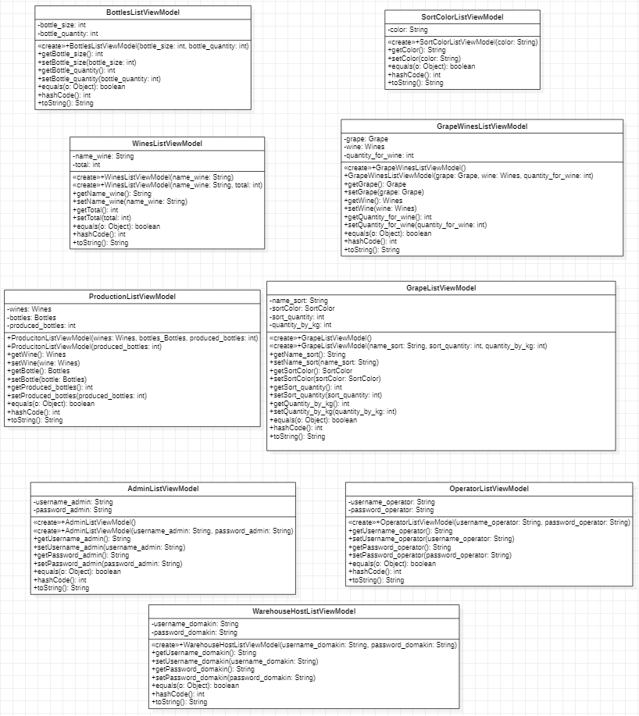
ListViewModels – Class Diagram

Slide 9
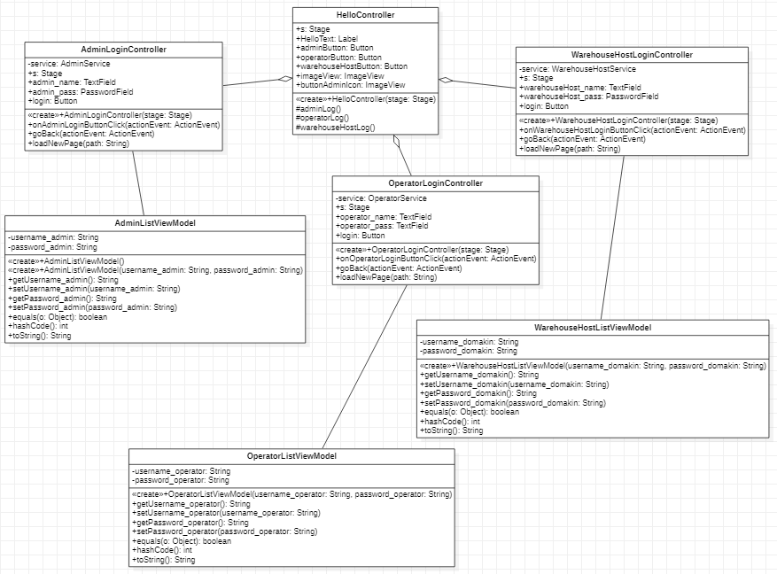
Home page – Class Diagram

Slide 10
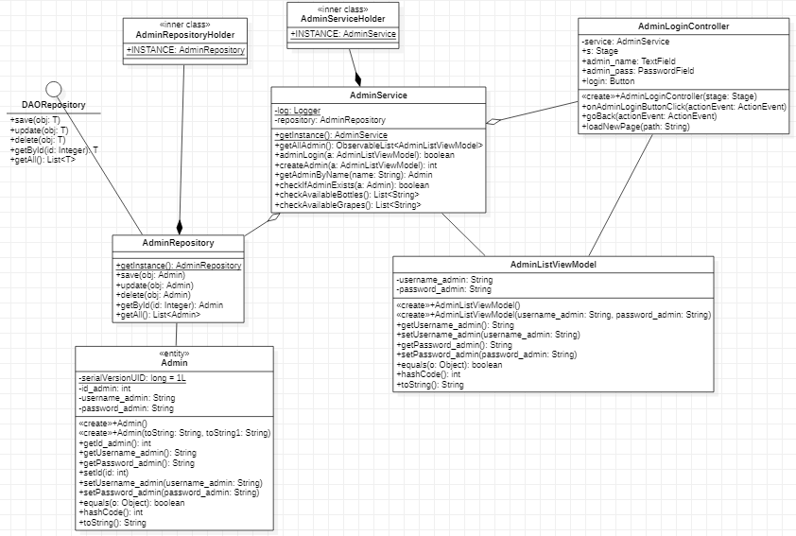
Admin Login – Class Diagram

Slide 11
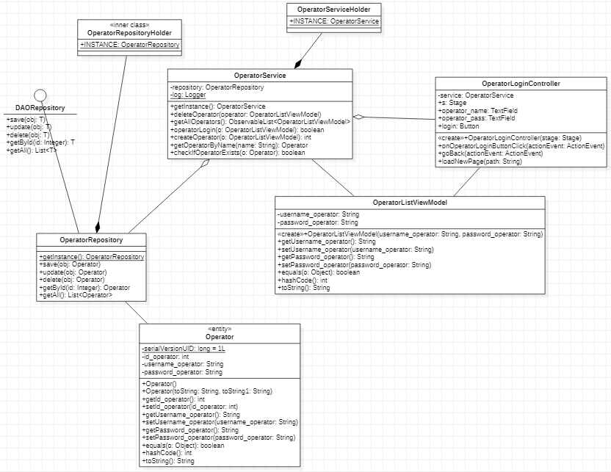
Operator Login – Class Diagram

Slide 12
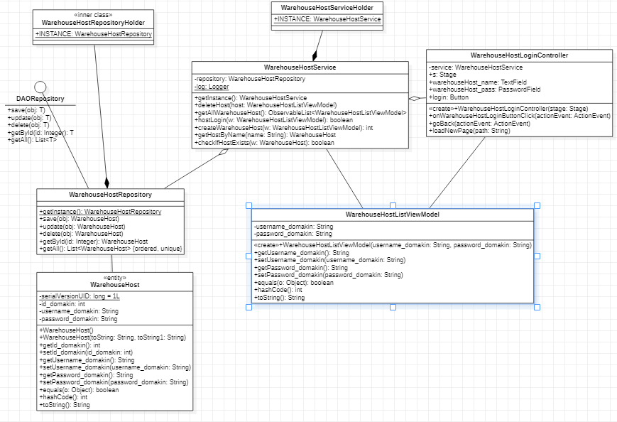
Warehouse Host Login – Class Diagram

Slide 13
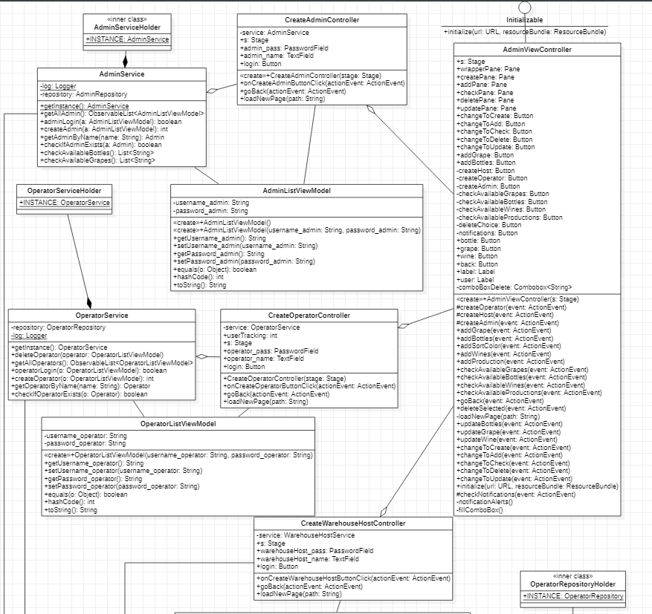
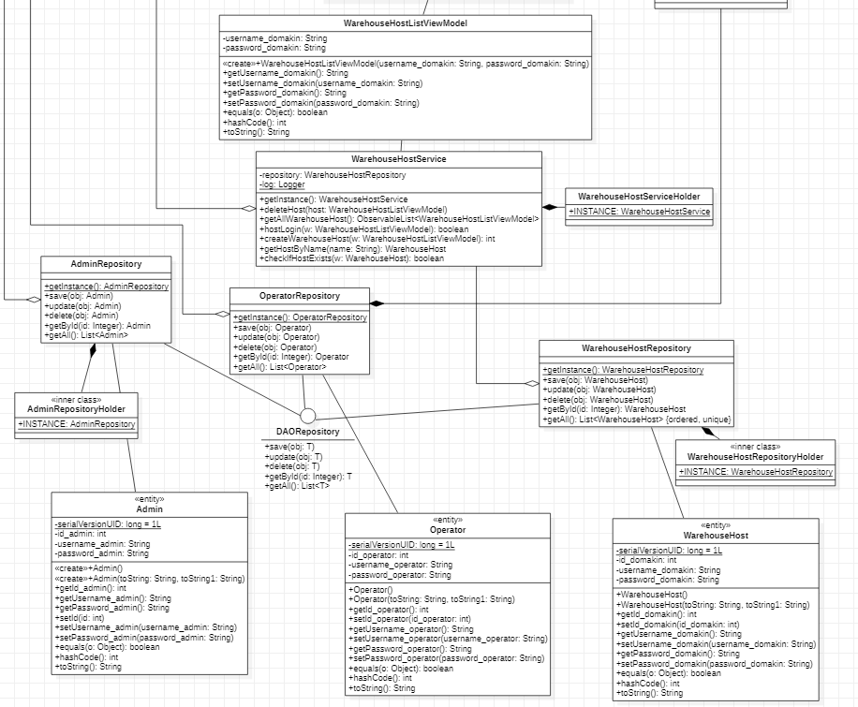
Create Users – Class Diagram

Slide 14
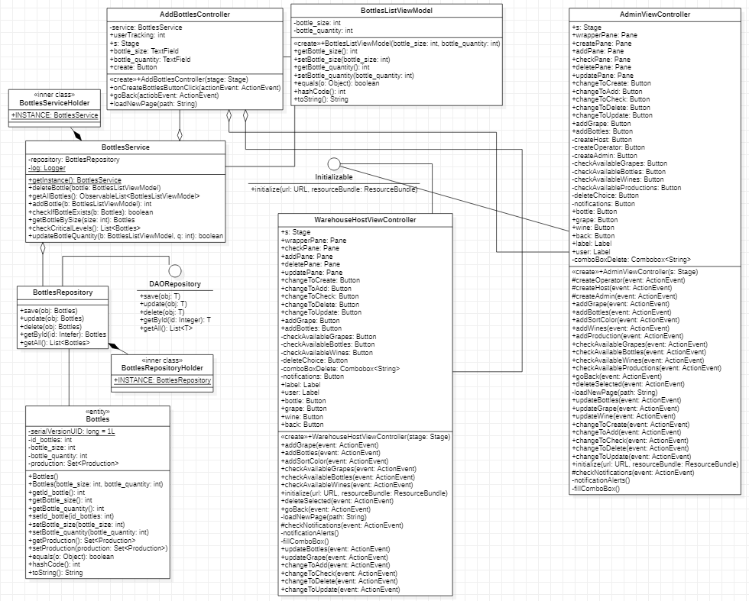
Add Bottle – Class Diagram

Slide 15
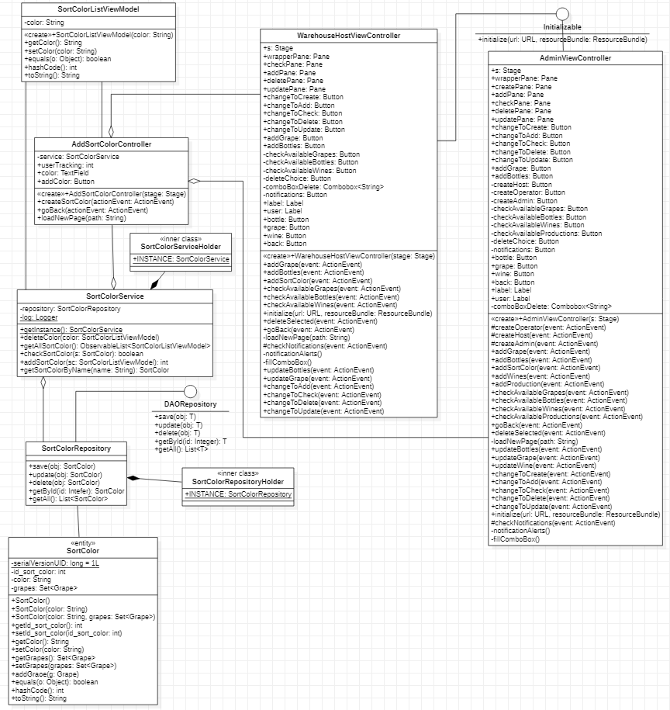
Add Color for Grape – Class Diagram

Slide 16
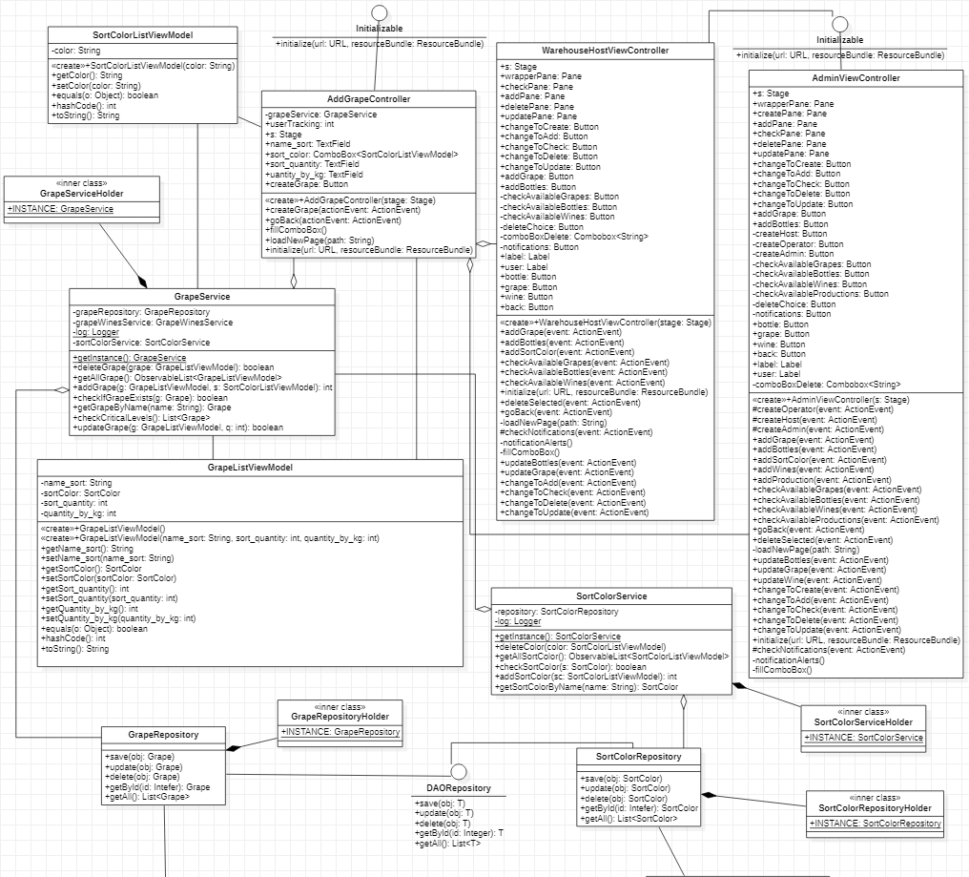
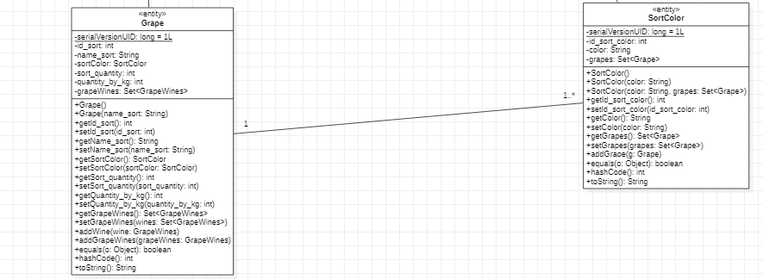
Add Grape – Class Diagram

Slide 17
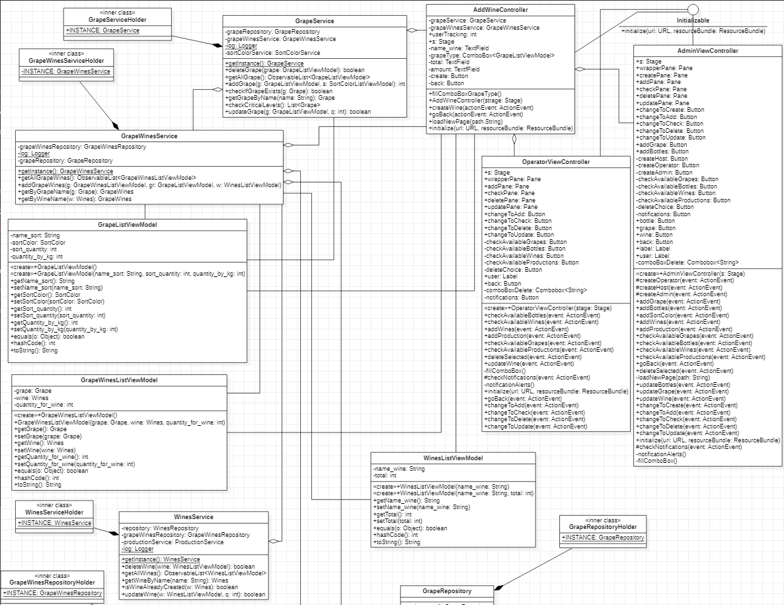
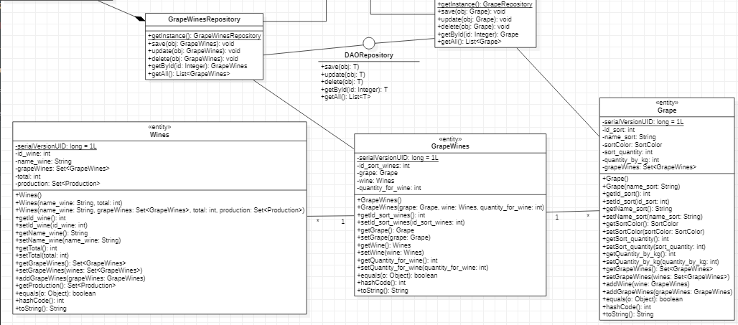
Add Wine – Class Diagram

Slide 18
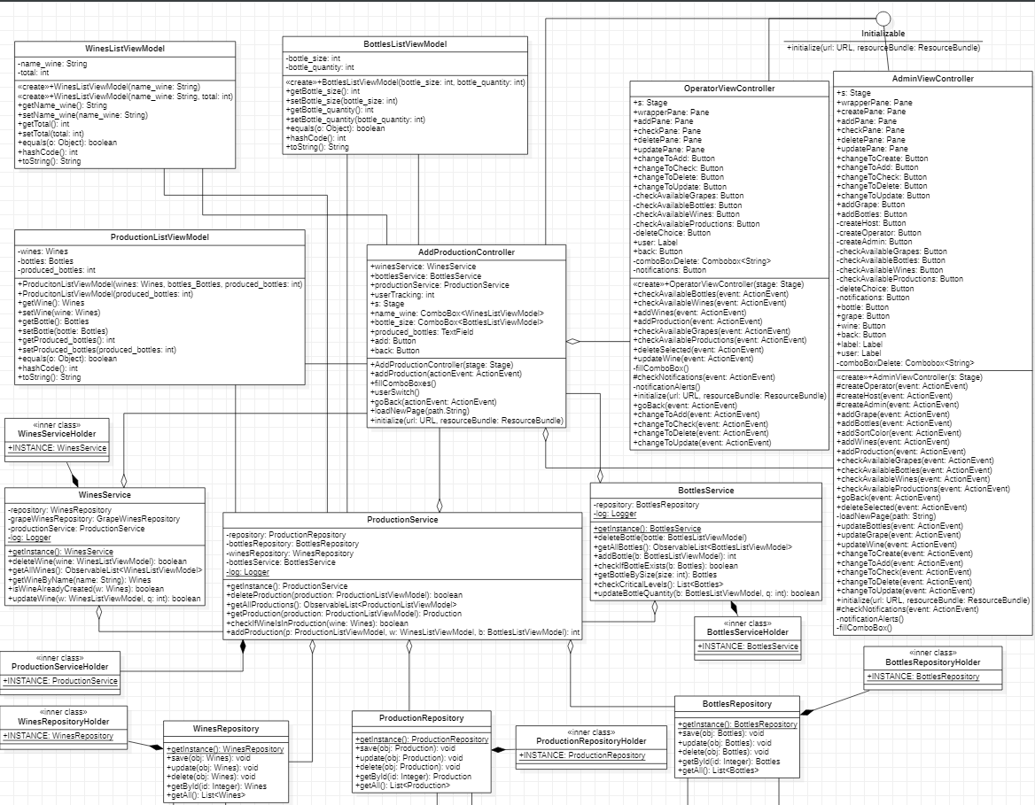
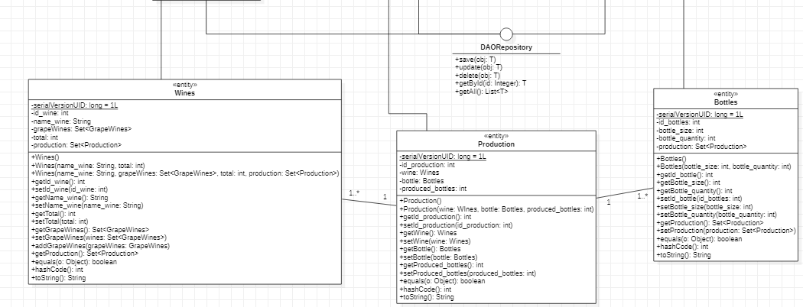
Add Production – Class Diagram

Slide 19
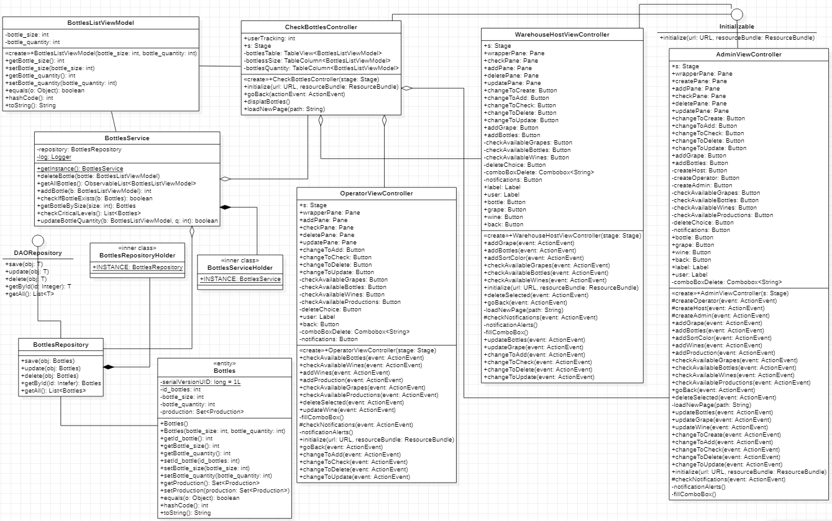
Check Bottle Quantity – Class Diagram

Slide 20
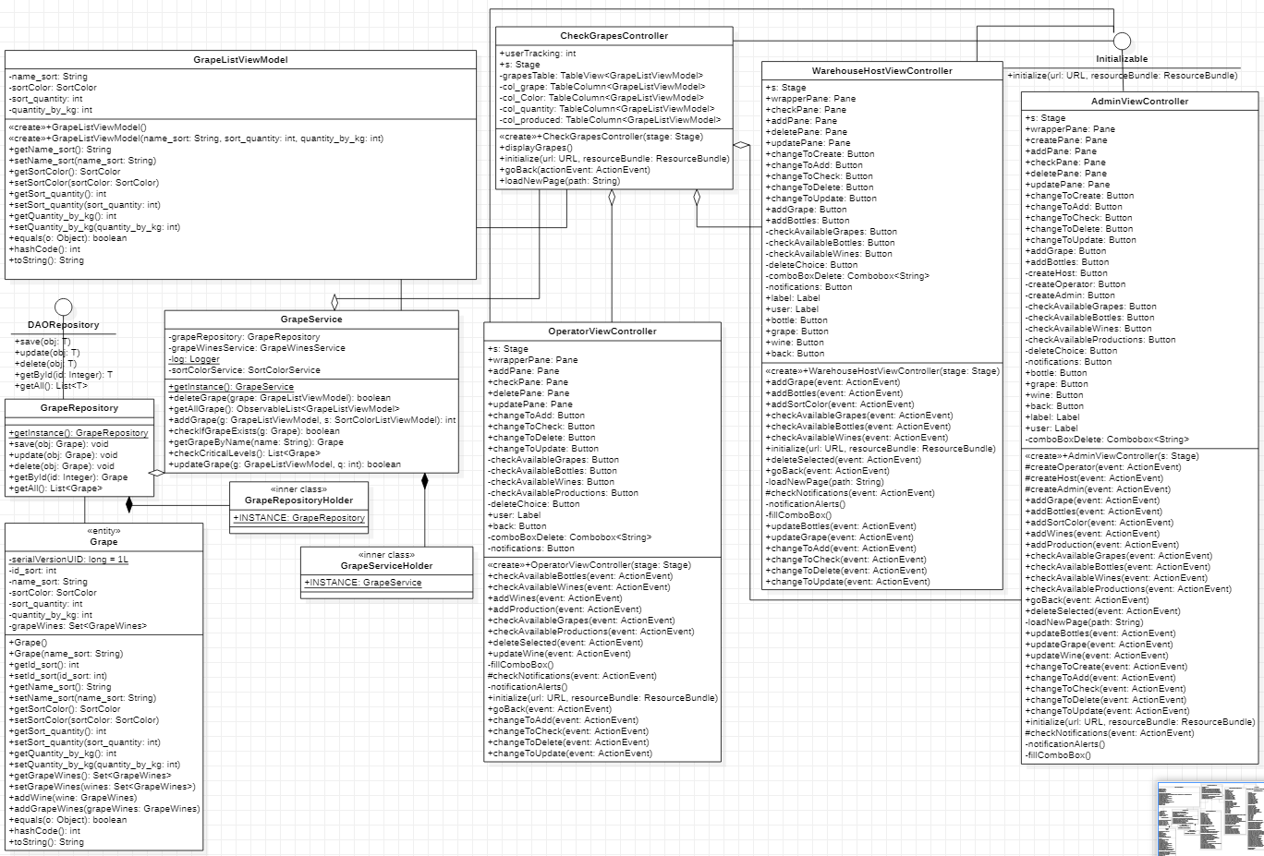
Check Grape Quantity – Class Diagram

Slide 21
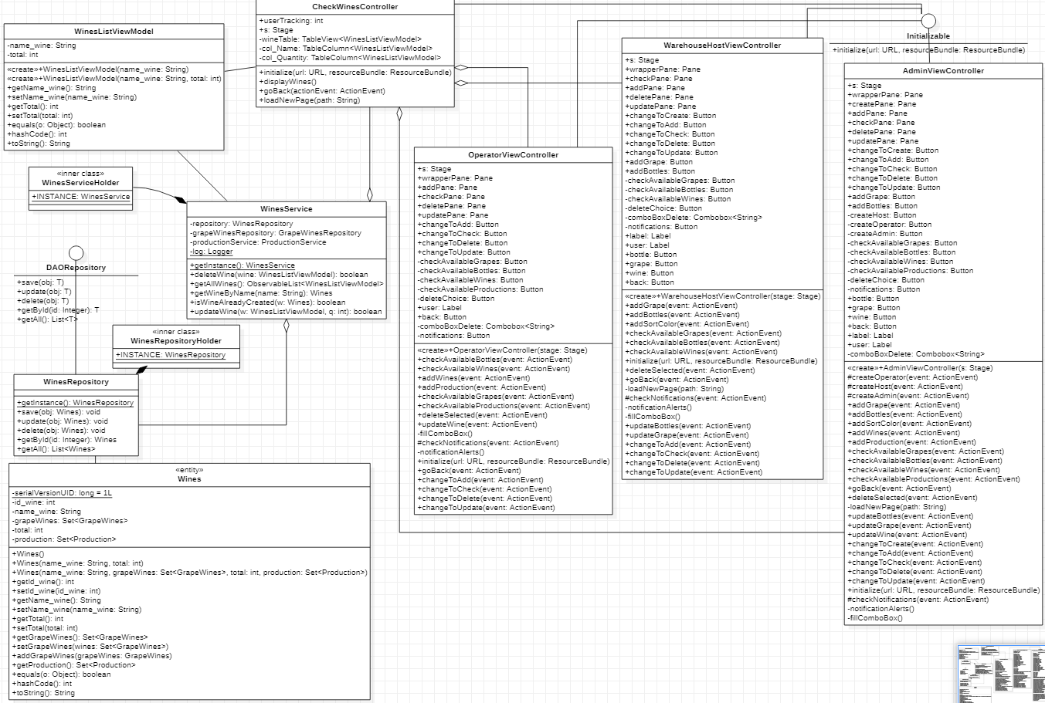
Check Wine Quantity – Class Diagram

Slide 22
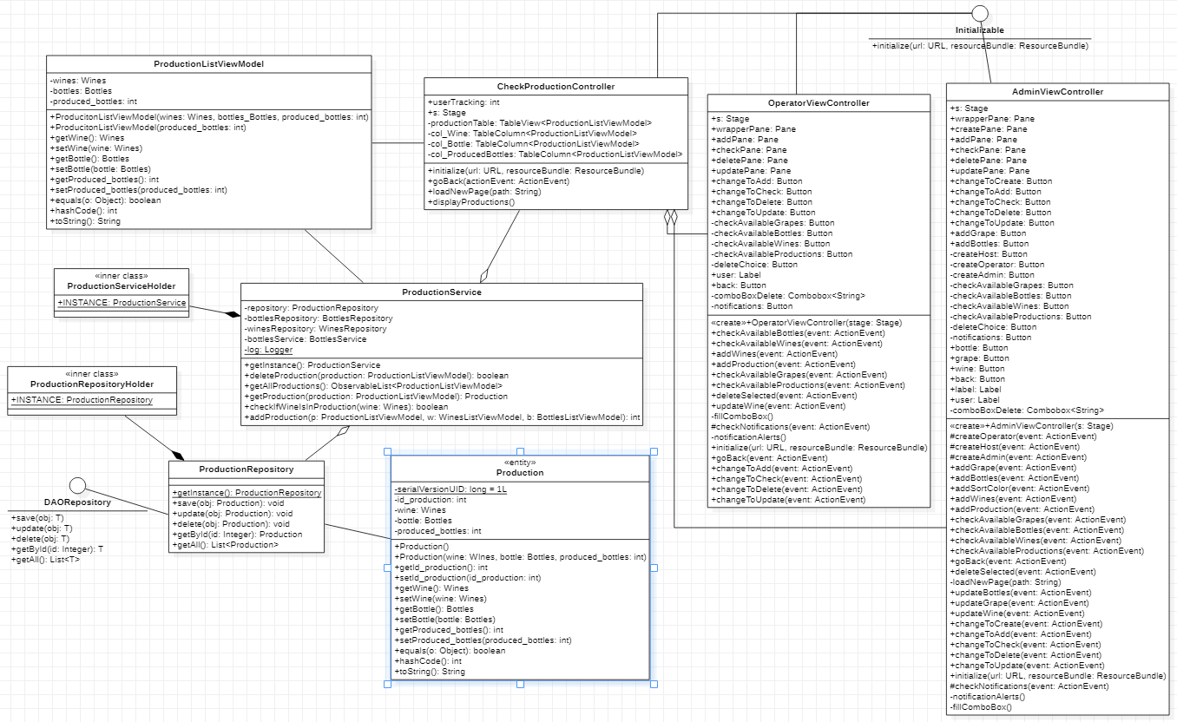
Check Production Cycles – Class Diagram

Slide 23
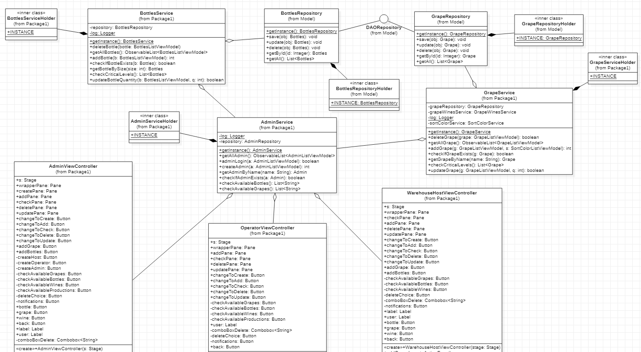
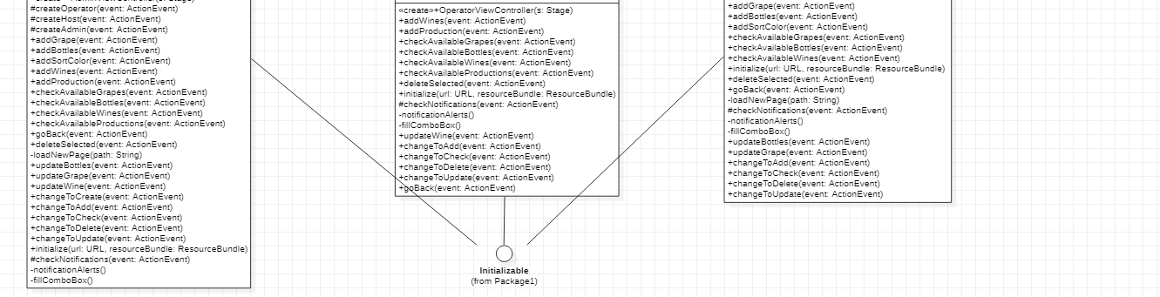
Check Critical Quantities – Class Diagram

Slide 24
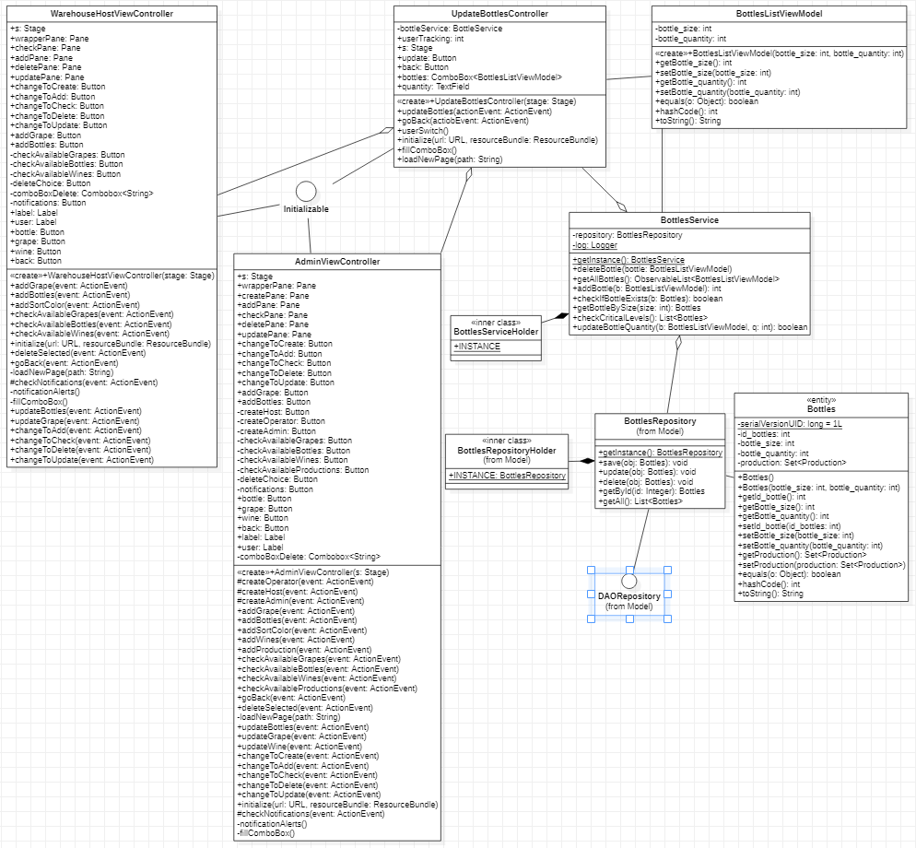
Update Bottle Quantity – Class Diagram

Slide 25
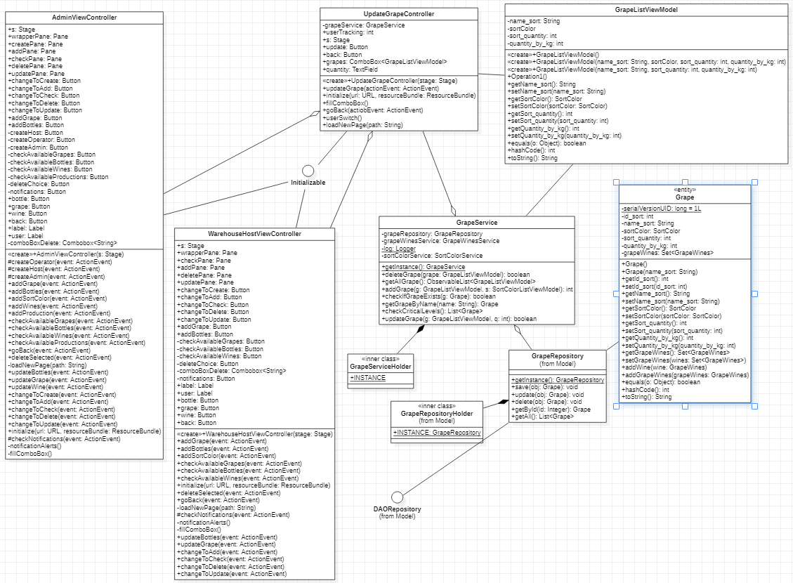
Update Grape Quantity – Class Diagram

Slide 26
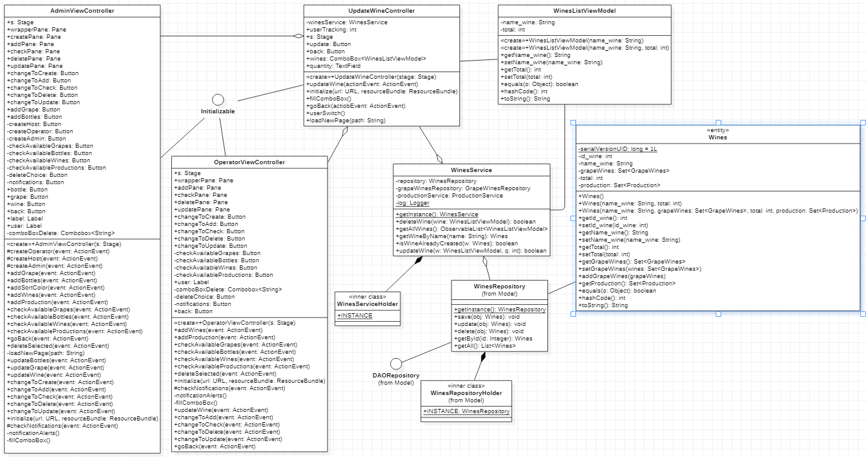
Update Wine Quantity – Class Diagram

Slide 27
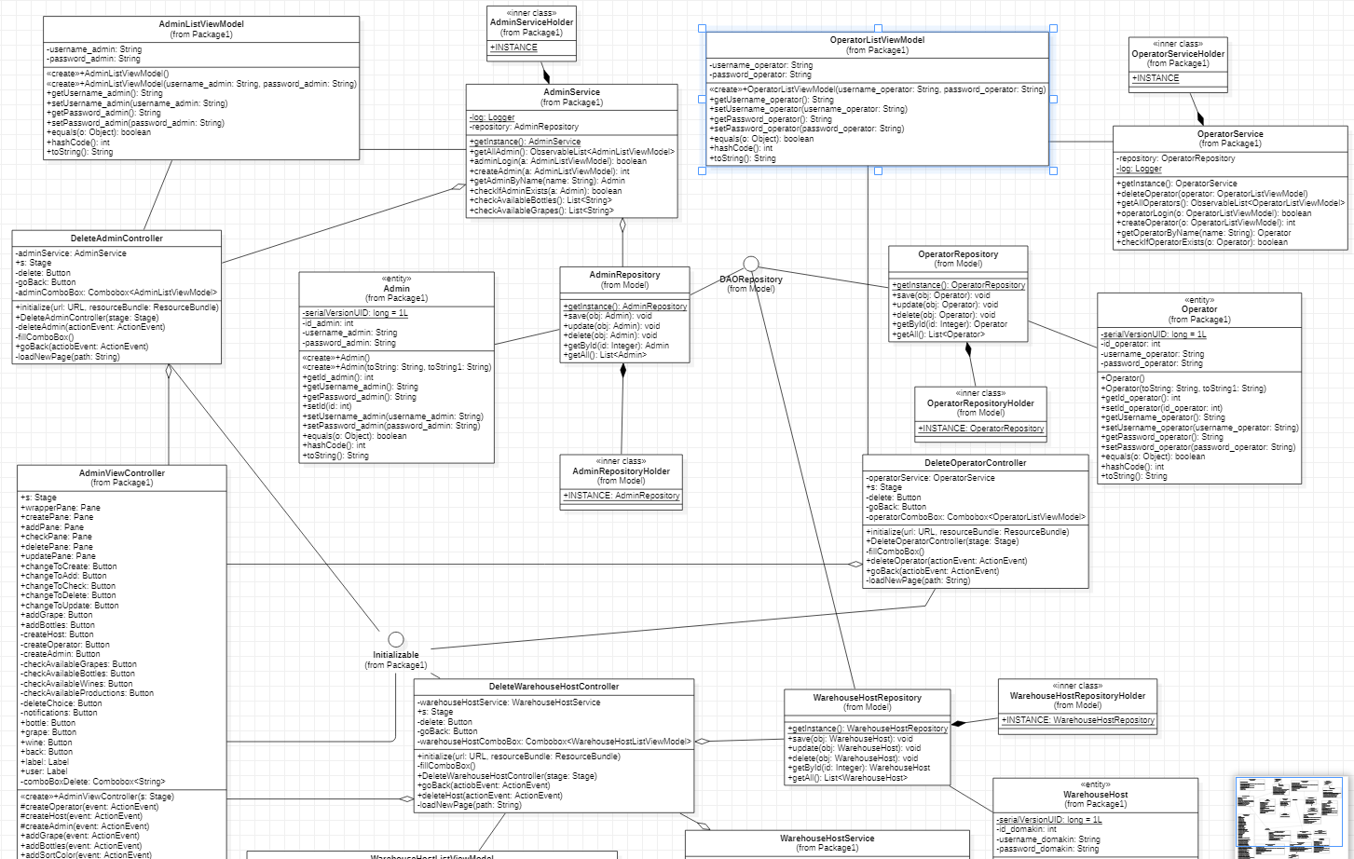
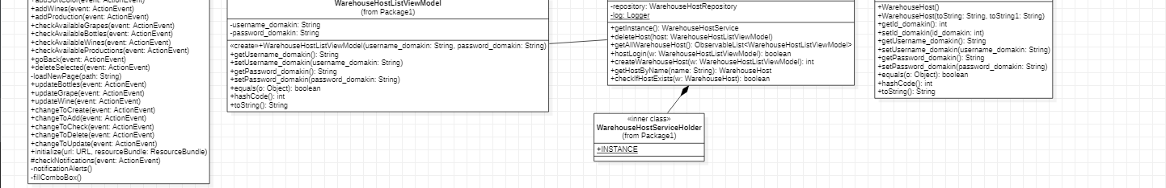
Delete Users – Class Diagram

Slide 28
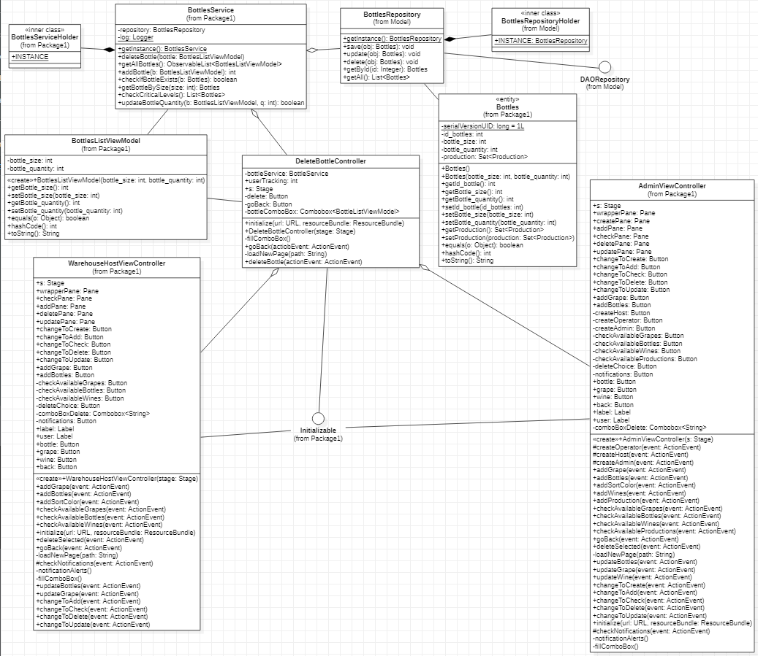
Delete Bottles – Class Diagram

Slide 29
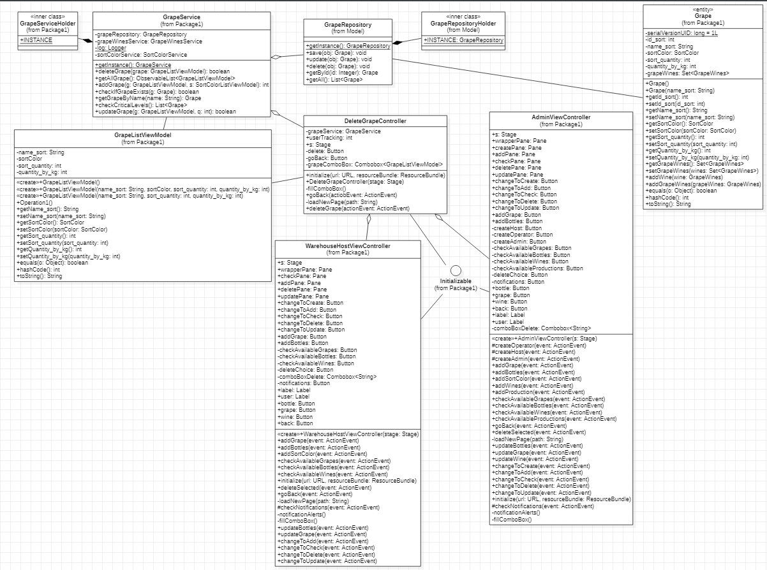
Delete Grape – Class Diagram

Slide 30
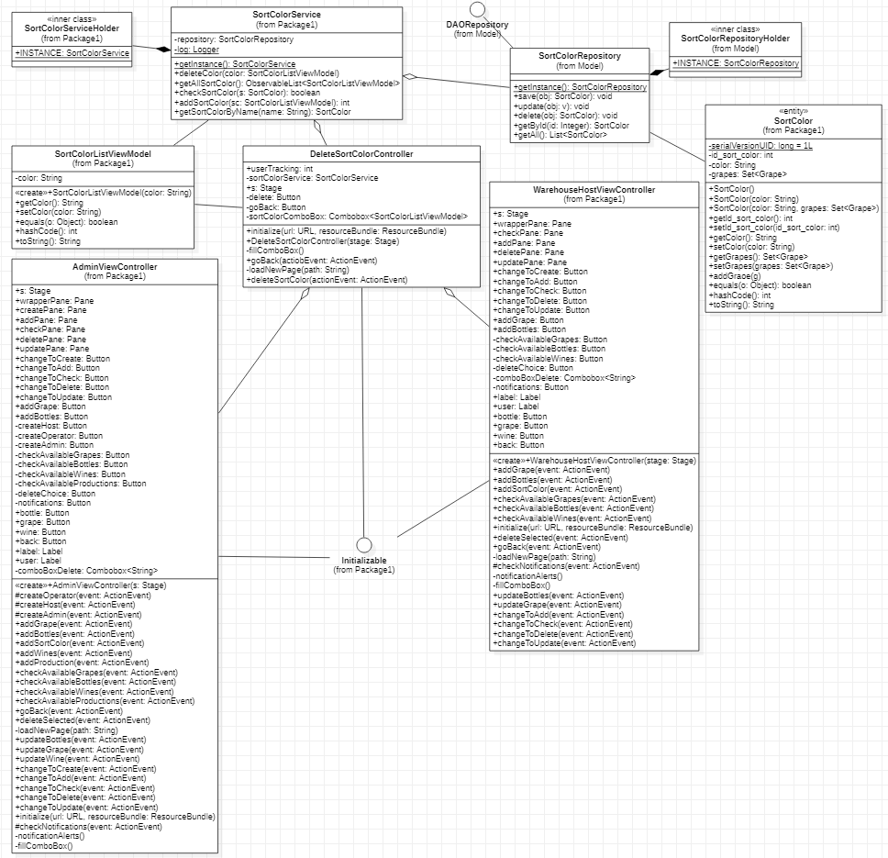
Delete Grape Color – Class Diagram

Slide 31
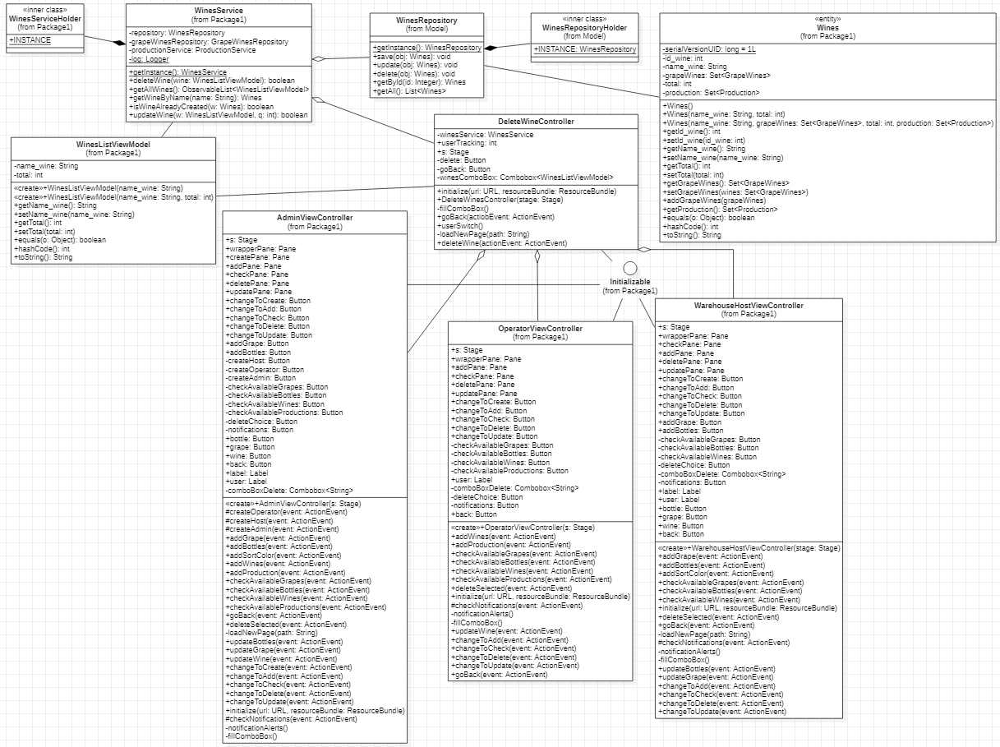
Delete Wine – Class Diagram

Slide 32
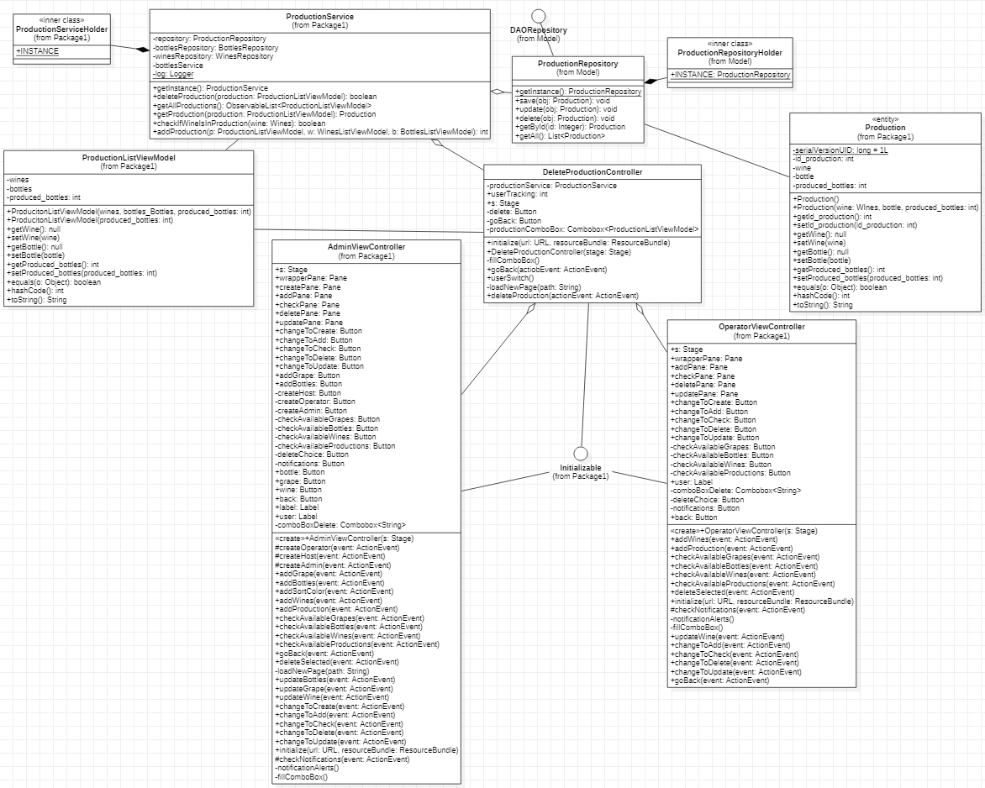
Delete Production Cycle – Class Diagram

Slide 33
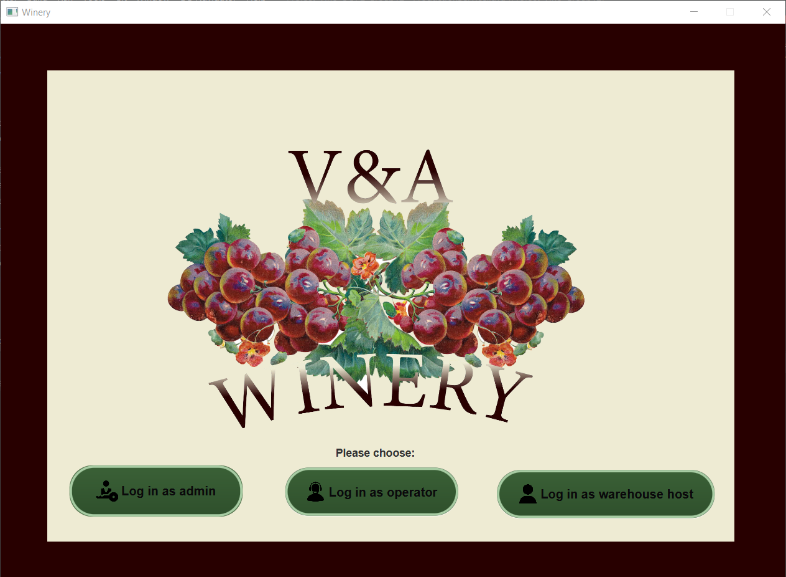
Home Page

Slide 34
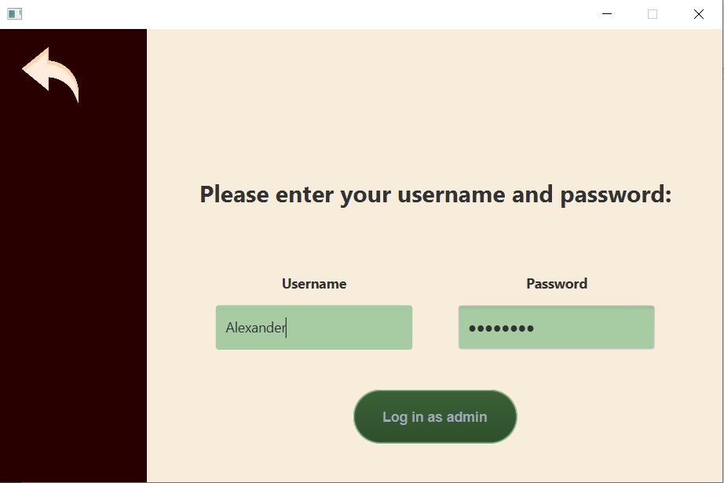
Login Page

Slide 35
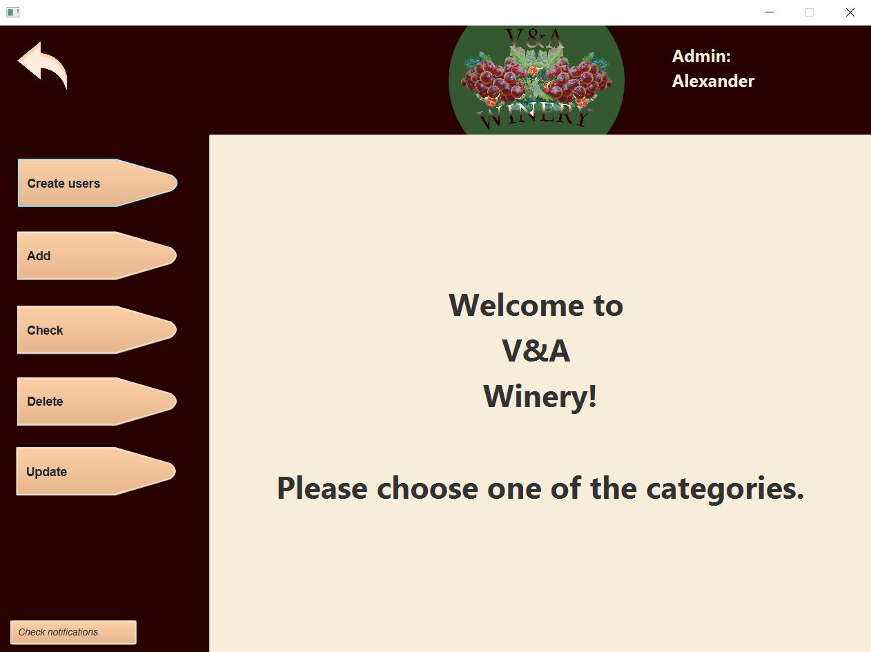
Home Menu

Slide 36
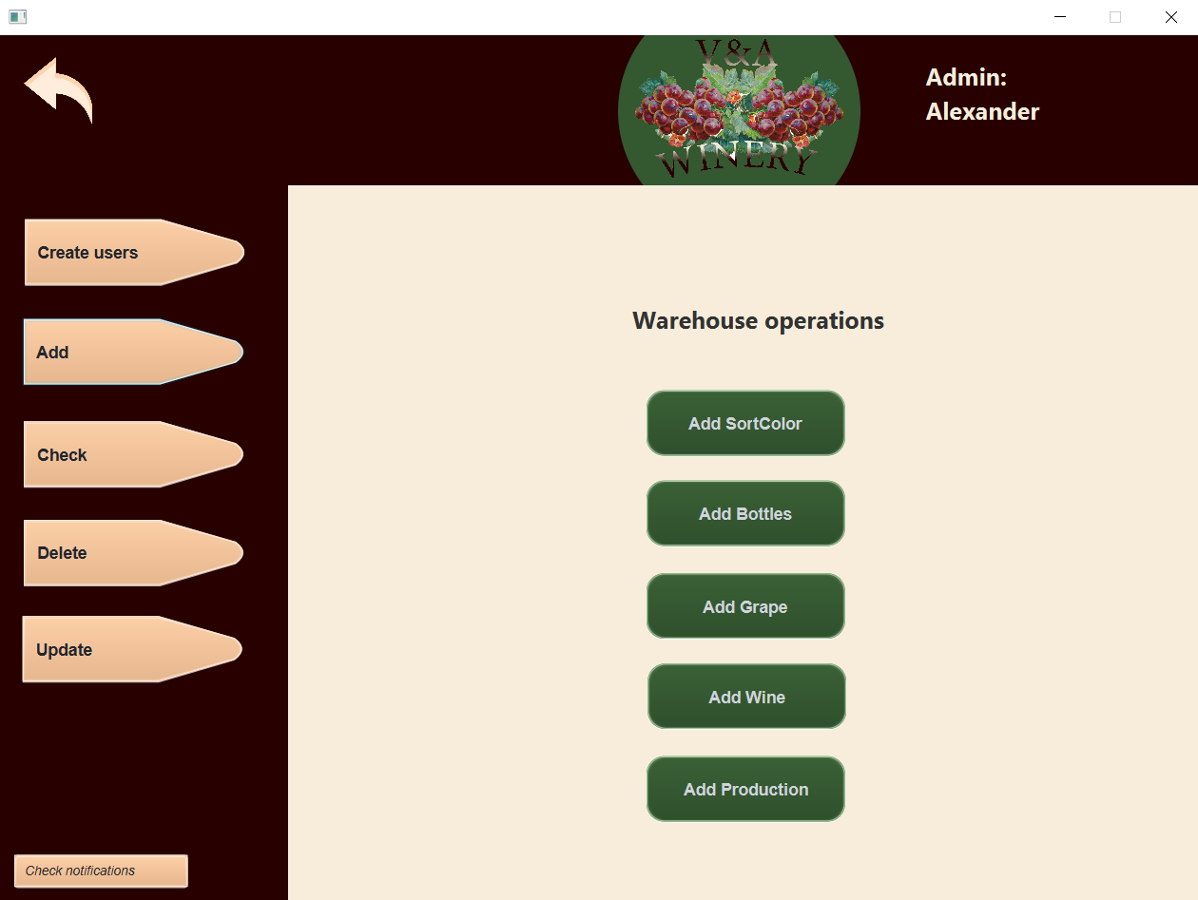
Add page

Slide 37
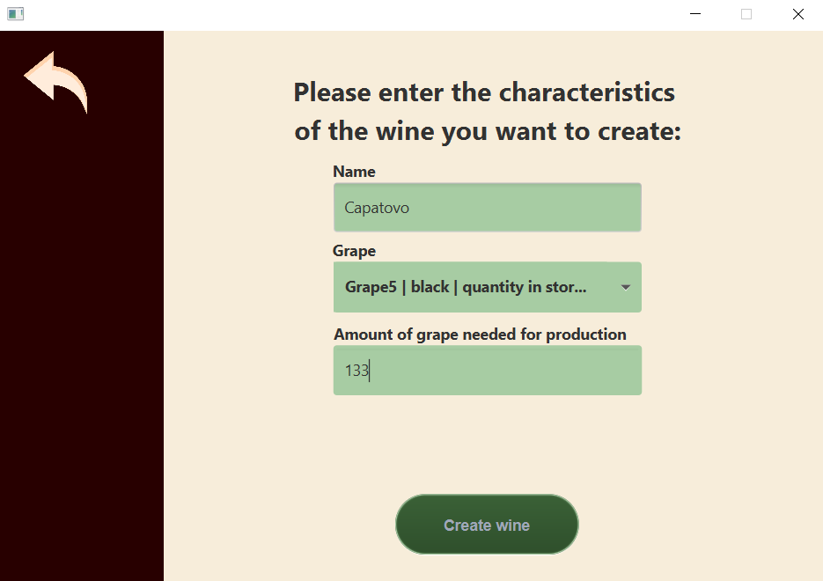
Add wine page

Slide 38
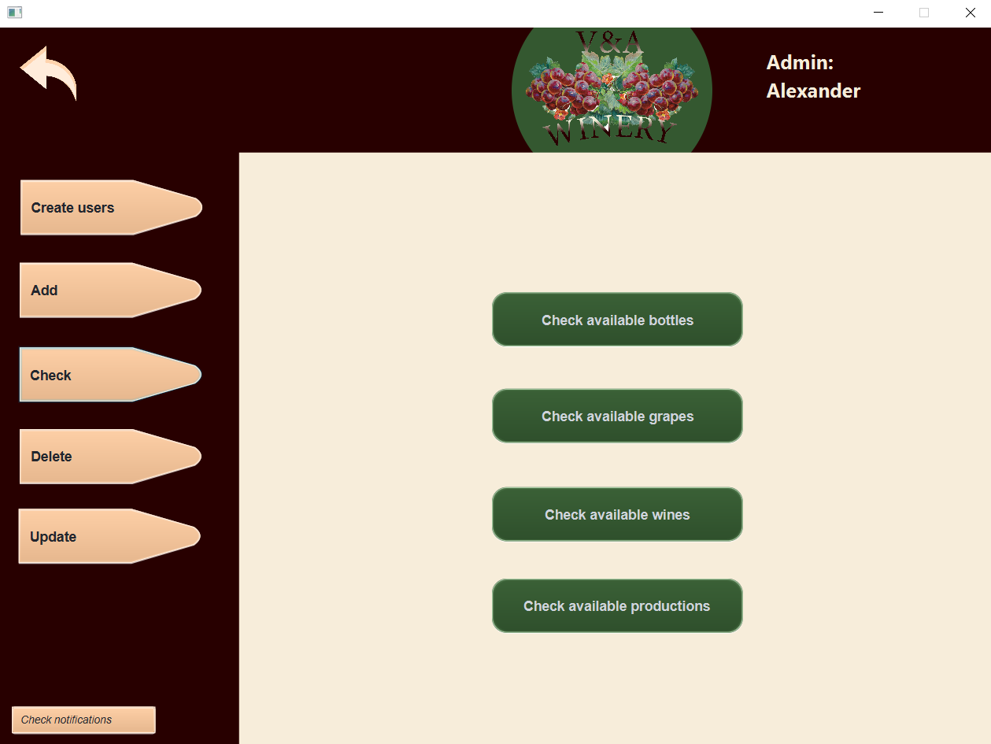
Check home page

Slide 39
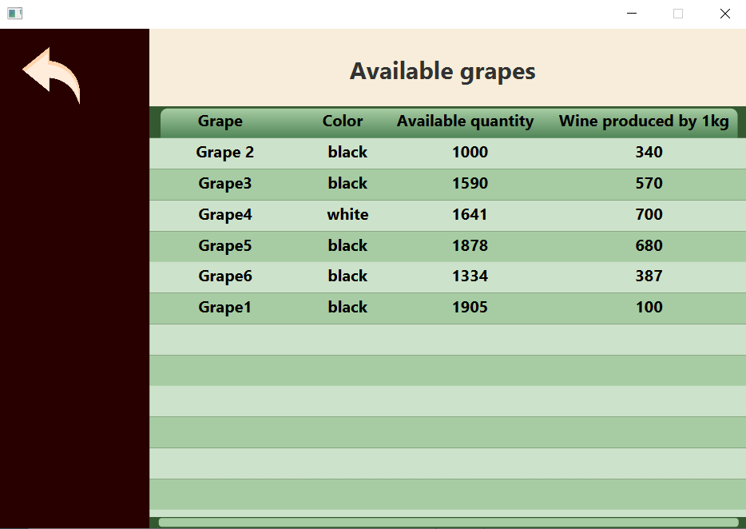
Check grape page

Slide 40
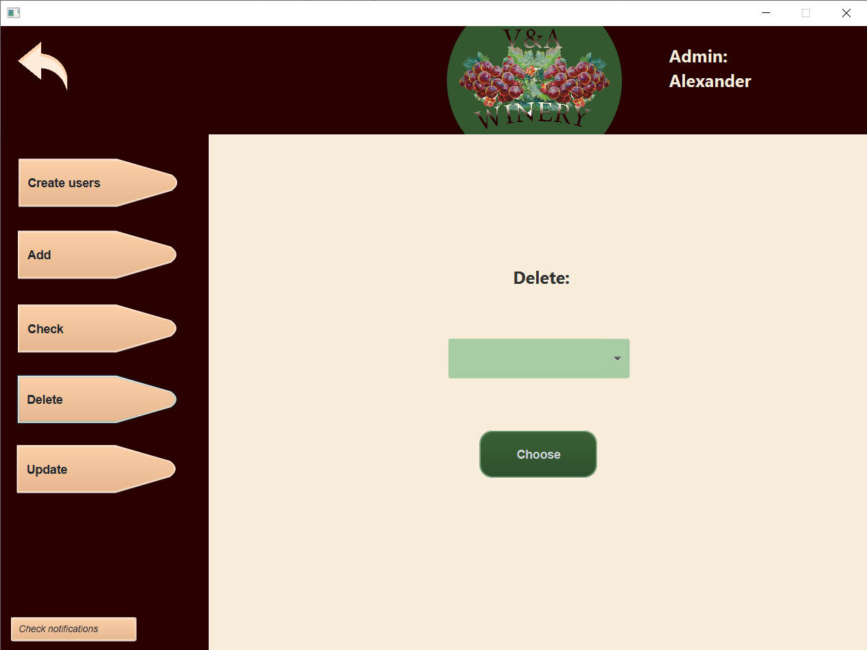
Delete home page

Slide 41
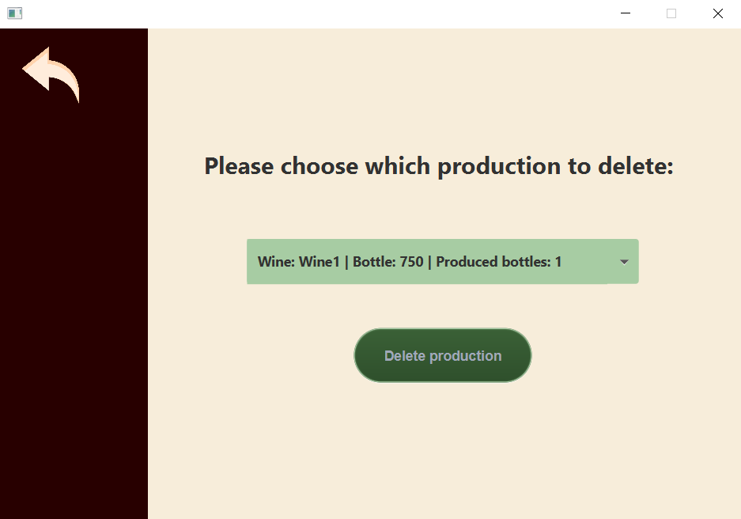
Delete production page

Slide 42
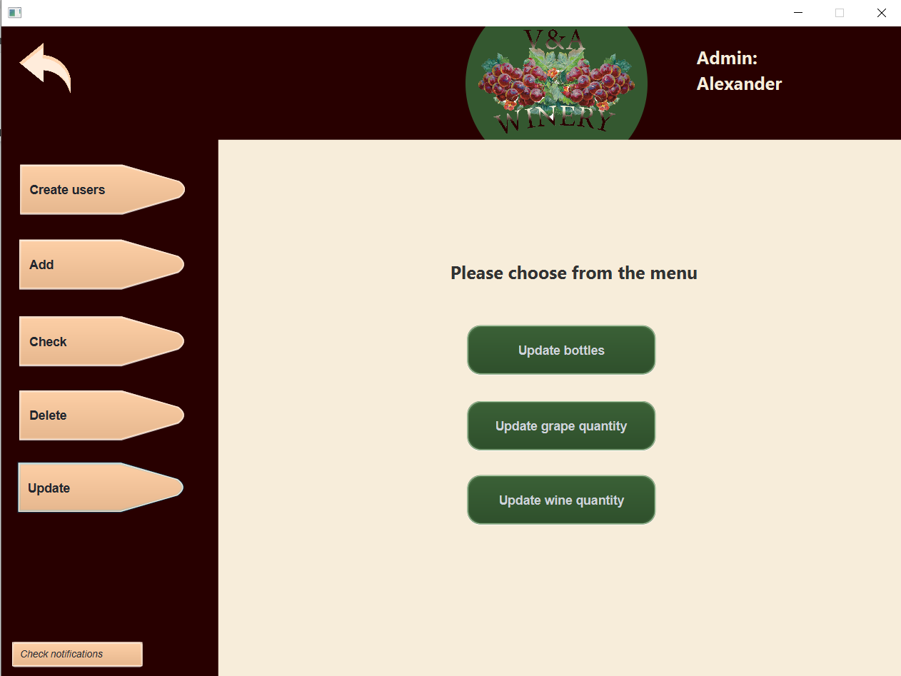
Update home page

Slide 43
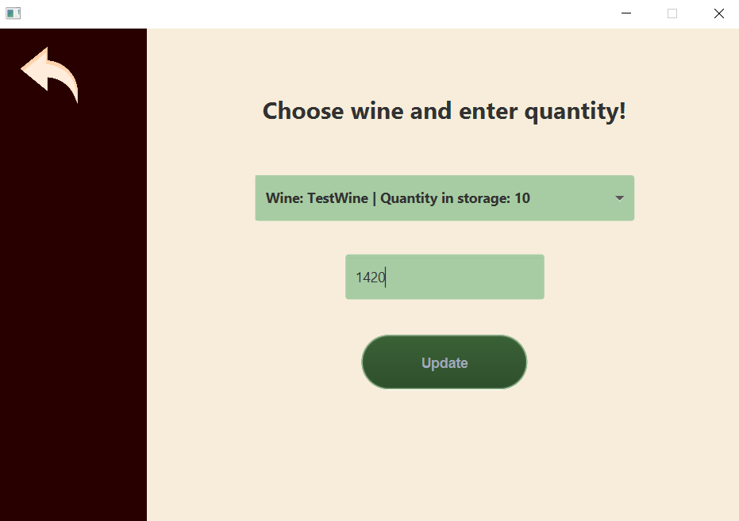
Update wine quantity page

Slide 44
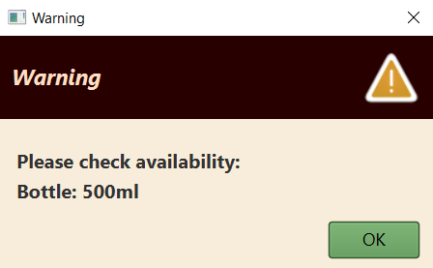
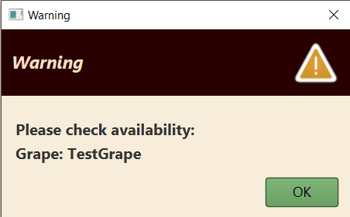
Critical level alerts

Slide 45
Thank you for the attention!

